Slide 1
Genito urinary system

Slide 2
The urinary system consists of:
The kidneys, which produce the urine.
An excretory duct system (renal calyces, renal pelves, and ureters) that transports the urine.
The bladder, where the urine is stored.
The urethra, which conveys the urine from the bladder for excretion.

Slide 3
Kidneys
There are three areas of tissue that can be distinguished when a longitudinal section of the kidney is viewed with the naked eye
An outer fibrous capsule, surrounding the kidney
The cortex, a reddish-brown layer of tissueimmediately below the capsule and outside the renal pyramids
The medulla, the innermost layer, consisting of pale conical-shaped striations, the renal pyramids.
The hilum is the concave medial border of the kidney where the renal blood and lymph vessels, the ureter and nerves enter.
Urine formed within the kidney passes through a renalpapilla at the apex of a pyramid into a minor calyx

Slide 4
Several minor calyces merge into a major calyx and two or three major calyces combine forming the renal pelvis, a funnel shaped structure that narrows when it leaves the kidney as the ureter.
The walls of the calyces and renal pelvis are lined with transitional epithelium and contain smooth muscle.
Peristalsis, intrinsic contraction of smooth muscle, propels urine through the calyces, renal pelvis and ureters to the bladder.

Slide 5
Functions of the kidney
Detoxification- Common waste products include nitrogen waste (urea), muscle waste (creatinine) and acids.
Control the acid-base balance (pH balance) of your blood.
Make sugar (glucose) if your blood doesn’t have enough sugar.
Make a protein called renin that increases blood pressure.
Produce the hormones calcitriol and erythropoietin. Calcitriol is a form of vitamin D that helps your body absorb calcium. Erythropoietin helps your body make red blood cells.

Slide 6
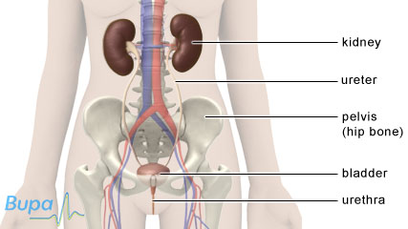

Slide 7
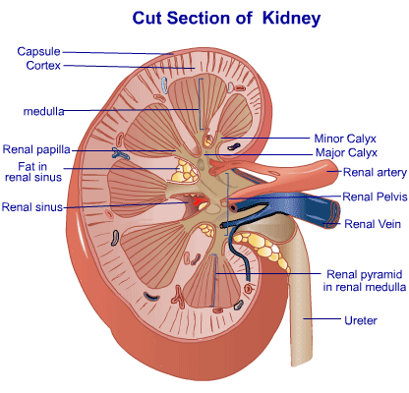

Slide 8
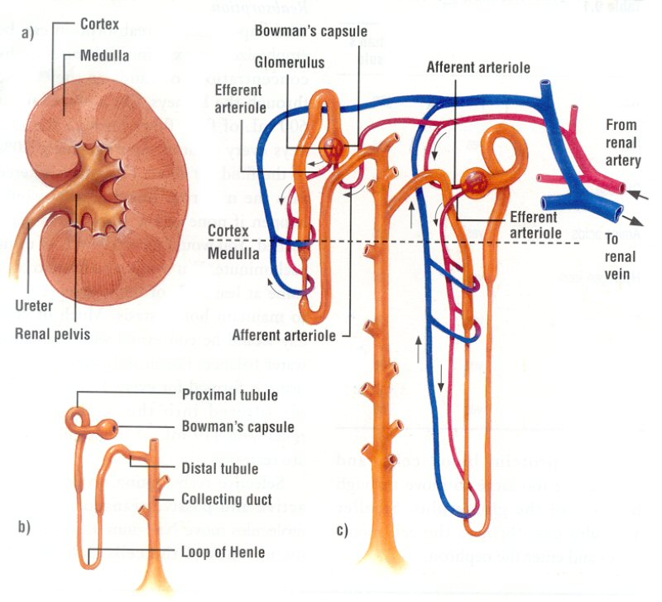

Slide 9
The Nephron
The nephron is the basic functional unit of the kidney, which is divided into glomerulus and tubules (the proximal and distal tubules).
Nephrons originating in the inner one-third of the cortex (the juxtamedullary nephrons) have longer loops of Henle than the more numerous cortical nephrons - those originating in the outer 2/3 of the cortex.

Slide 10
Functional physiology of the nephron
Juxtaglomerular apparatus | Renin production
Glomerulus | Produces ultrafiltrate of plasma (glomerular filtration rate 120 mL/min)
Proximal convoluted tubule | Resorption of: Water (80%) Glucose (100%) K+ (100%) Amino acids (100%)
Loop of Henle and vasa recta | Countercurrent exchange and multiplier mechanisms
Distal convoluted tubule and collecting duct | Resorption of: Water (antidiuretic hormone–controlled) Na+ (in exchange for K+ and H+, controlled by aldosterone) Acidification

Slide 11
The following changes in the tubular fluid occur in the distal convoluted and collecting tubules:
Water reabsorption occurs under the influence of antidiuretic hormone.
Sodium reabsorption occurs under the influence of aldosterone in exchange for potassium and hydrogen ions.
Acidification of urine occurs. The total acid excreted per day by the kidney is only about 1% of that excreted by the lungs as CO₂. Nonetheless, failure of this mechanism will, after several days, result in metabolic acidosis.
Excreted urine contains precisely regulated quantities of sodium, potassium, water, chloride, bicarbonate, phosphate, and ammonium ions.

Slide 12
Juxstaglomerular Apparatus (JGA)
This is the point where the afferent arteriole enters the glomerulus. It is modified granular smooth muscle cells occupying the media of the afferent arteriole.
It secretes renin that is essential in blood pressure regulation.

Slide 13
Glomerular filtration rate
The glomerular filtration rate (GFR) is normally about 120 mL/min

Slide 14
Renal Regulation of Blood Pressure and Blood Volume
The kidneys play a major part in regulating both the blood pressure and the blood volume by secreting a substance called renin.
Renin is released in response to a drop in blood pressure, a reduction in blood volume, or a low concentration of sodium in the blood plasma. It produces effects that tend to restore these alterations toward normal.
Renin interacts with a blood protein called renin substrate in two stages to yield a product called angiotensin.
Angiotensin I is converted into angiotensin II, a powerful vasoconstrictor that raises the blood pressure by causing the peripheral arterioles to constrict.
Angiotensin II also stimulates the adrenal cortex to secrete a steroid hormone called aldosterone, which increases reabsorption of sodium chloride and water by the kidneys. As a result, the blood volume is increased by the greater volume of salt and water entering the circulation and the blood pressure rises because there is more fluid within the vascular system.
Thus, renin regulates blood pressure both by controlling the degree of arteriolar vasoconstriction and by regulating the volume of fluid within the circulation.

Slide 15
THE URETERS
The ureters are muscular tubes that propel the urine into the bladder by wavelike contractions of their muscular walls (peristalsis).
Urine is discharged into the bladder in spurts. It does not drain by gravity.
THE BLADDER AND URETHRA
The urinary bladder is the distensible reservoir for urine. It is lined by transitional epithelium continuous with that which lines the remainder of the urinary tract. The opening of the urethra is located at the base of the bladder, and the ureteral openings are located on either side and behind the urethral opening.
The triangular area at the base of the bladder bounded by the two ureteral orifices posteriorly and the urethral orifice anteriorly is called the trigone of the bladder (tri = three).

Slide 16
The bladder expands like an elastic sac to hold more urine.
As it reaches capacity, the process of micturition, or urination, begins. I
Involuntary muscle movements send signals to the nervous system, putting the decision to urinate under conscious control.
The internal urethral sphincter and the external urethral sphincter both provide muscle control for the flow of urine.
The internal sphincter is involuntary. It surrounds the opening of the bladder to the urethra and relaxes to allow urine to pass.
The external sphincter is voluntary. It surrounds the urethra outside the bladder and must be relaxed for urination to occur.

Slide 17
Functions of the urinary system
Regulation of plasma ionic composition. Ions such as sodium, potassium, calcium, magnesium, chloride, bicarbonate, and phosphates are regulated by the amount that the kidney excretes.
Regulation of plasma osmolarity. The kidneys regulate osmolarity because they have direct control over how many ions and how much water a person excretes.
Regulation of plasma volume. Your kidneys are so important they even have an effect on your blood pressure. The kidneys control plasma volume by controlling how much water a person excretes. The plasma volume has a direct effect on the total blood volume, which has a direct effect on your blood pressure. Salt(NaCl)will cause osmosis to happen; the diffusion of water into the blood.

Slide 18
Regulation of plasma hydrogen ion concentration (pH). The kidneys partner up with the lungs and they together control the pH. The kidneys have a major role because they control the amount of bicarbonate excreted or held onto. The kidneys help maintain the blood Ph mainly by excreting hydrogen ions and reabsorbing bicarbonate ions as needed.
Removal of metabolic waste products and foreign substances from the plasma. One of the most important things the kidneys excrete is nitrogenous waste. As the liver breaks down amino acids it also releases ammonia. The liver then quickly combines that ammonia with carbon dioxide, creating urea which is the primary nitrogenous end product of metabolism in humans.
The liver turns the ammonia into urea because it is much less toxic. We can also excrete some ammonia, creatinine and uric acid. The creatinine comes from the metabolic breakdown of creatine phospate (a high-energy phosphate in muscles).
Uric acid comes from the break down of nucleotides. Uric acid is insoluble and too much uric acid in the blood will build up and form crystals that can collect in the joints and cause gout.

Slide 19
Secretion of Hormones The endocrine system has assistance from the kidney's when releasing hormones.
Renin is released by the kidneys. Renin leads to the secretion of aldosterone which is released from the adrenal cortex.
Aldosterone promotes the kidneys to reabsorb the sodium (Na+) ions.
The kidneys also secrete erythropoietin when the blood doesn't have the capacity to carry oxygen. Erythropoietin stimulates red blood cell production.
The Vitamin D from the skin is also activated with help from the kidneys. Calcium (Ca+) absorption from the digestive tract is promoted by vitamin D.

Slide 20
Sites of erythropoiesis
The site of erythropoiesis changes throughout life. In the very early foetus, it occurs in the yolk sac.
From 2 – 5 months’ gestation it occurs in the liver and spleen before finally establishing in the bone marrow from about 5 months’ gestation.
In children, erythropoiesis can occur in the bone marrow of most bones.
However, in adults, it only occurs in the bone marrow of the vertebrae, ribs, sternum, sacrum, pelvis and proximal femur.

Slide 21
When erythropoiesis is inadequate in the bone marrow, this can trigger extramedullary haematopoiesis – i.e. haematopoiesis occurring outside the marrow.
This is commonly seen in haemoglobulinopathies such as thalassaemias and myelofibrosis.

Slide 22
Stages of erythropoiesis
The production of all blood cells begins with the haemocytoblast, a multipotent haematopoietic stem cell.
Haemocytoblasts have the greatest powers of self-renewal of any adult cell. They are found in the bone marrow and can be mobilised into the circulating blood when needed.
Some haemocytoblasts differentiate into common myeloid progenitor cells, which go on to produce erythrocytes, as well as mast cells, megakaryocytes and myeloblasts.

Slide 23
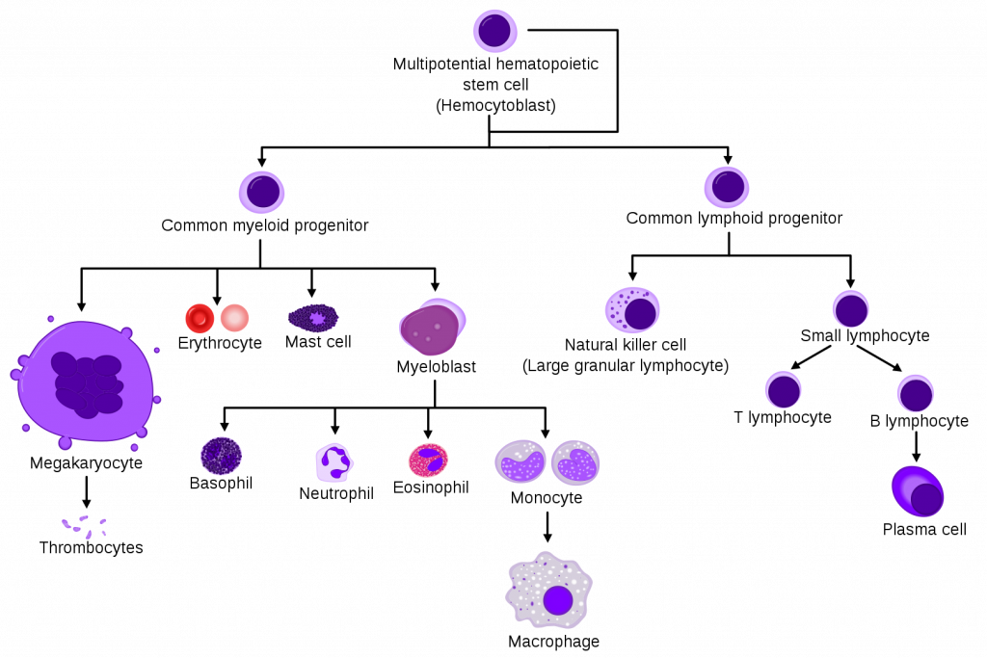

Slide 24
The process by which common myeloid progenitor cells become fully mature red blood cells involves several stages.
First, they become normoblasts (aka eryhthroblasts), which are normally present in the bone marrow only.
Then, they lose their nucleus as they mature into reticulocytes, which can be thought of as immature red blood cells. Some of these are released into the peripheral circulation.

Slide 25
Finally, reticulocytes lose their remaining organelles as they mature into erythrocytes-which are fully mature red blood cells. the average lifespan of a red blood cell is approximately 120 days.
During this maturation process, there is nuclear extrusion – i.e. mature erythrocytes have no nucleus. Nucleated red blood cells present in a sample of bone marrow can indicates the release of incompletely developed cells.
This can occur in pathology such as thalassaemia, severe anaemia or haematological malignancy.

Slide 26
Regulation of erythropoiesis
Erythropoiesis is driven mainly by the hormone erythropoietin (EPO), which is a glycoprotein cytokine.
EPO is secreted by the kidney. It is constantly secreted at a low level, sufficient for the normal regulation of erythropoiesis. However, if the erythrocyte level becomes inadequate, the blood becomes relatively hypoxic. When there is a reduced partial pressure of oxygen (pO2) in the kidney, this is detected by the renal interstitial peritubular cells.

Slide 27
In response, there is a surge in EPO production, which acts on the bone marrow to stimulate increased red blood cell production.
This causes haemoglobin levels to increase, subsequently causing the pO2 to rise and therefore EPO levels to fall.
The feedback loop is complete.

Slide 28
Regulation of vitamin D
Vitamin D is actually a hormone rather than a vitamin; it is required to absorb calcium from the gut into the bloodstream.
Vitamin D is mostly produced in the skin in response to sunlight and is also absorbed from food eaten
The liver and kidneys convert vitamin D (produced in the skin and taken up in the diet), into the active hormone, which is called calcitriol.
Active vitamin D helps to increase the amount of calcium the gut can absorb from eaten food into the bloodstream and also prevents calcium loss from the kidneys.
Vitamin D modifies the activity of bone cells and is important for the formation of new bone in children and adults.

Slide 29
A fall in the concentration of calcium in the bloodstream is detected by the parathyroid glands, which then produce parathyroid hormone.
Parathyroid hormone increases the activity of the enzyme (catalyst) that produces active vitamin D. This increase in the concentration of calcium together with vitamin D feeds back to the parathyroid glands to stop further parathyroid hormone release.
The production of vitamin D is also directly regulated by calcium, phosphate and calcitriol.
If you have severely low vitamin D levels you are unable to maintain an adequate concentration of calcium in your blood for bone growth.
This causes rickets in children and osteomalacia in adults.

